Slide 1

Phishing Awareness Training: Stay Alert, Stay Secure
Recognise • Resist • Report

Slide 2
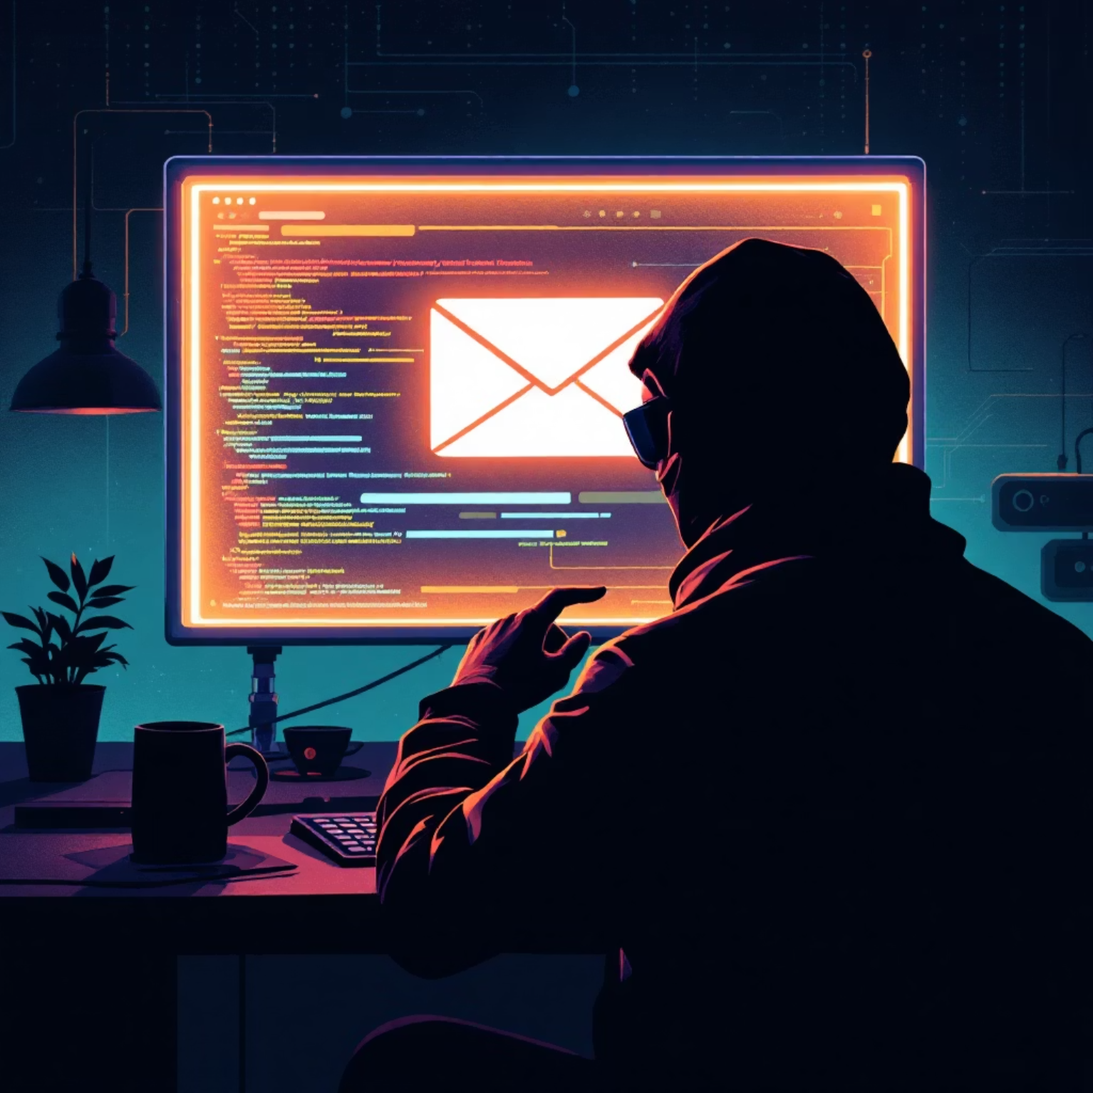
What Exactly is Phishing?
Phishing is a type of online fraud where attackers pretend to be legitimate entities to trick you into revealing sensitive information. Think of it as a digital fishing expedition, where they cast a wide net hoping someone takes the bait.
They're after details like usernames, passwords, credit card numbers, and other personal data. Once they have this information, they can use it for identity theft, financial fraud, or to gain access to your accounts.

Slide 3

Common Types of Phishing Attacks
Email Phishing
SMS Phishing (Smishing)
The classic approach, using deceptive emails to lure victims.
Malicious messages sent via text, often with fake links.
Voice Phishing (Vishing)
Fake Websites & Social Media Scams
Fraudulent phone calls designed to trick you into sharing info.
Crafty websites or social media profiles designed to mimic real ones.

Slide 4
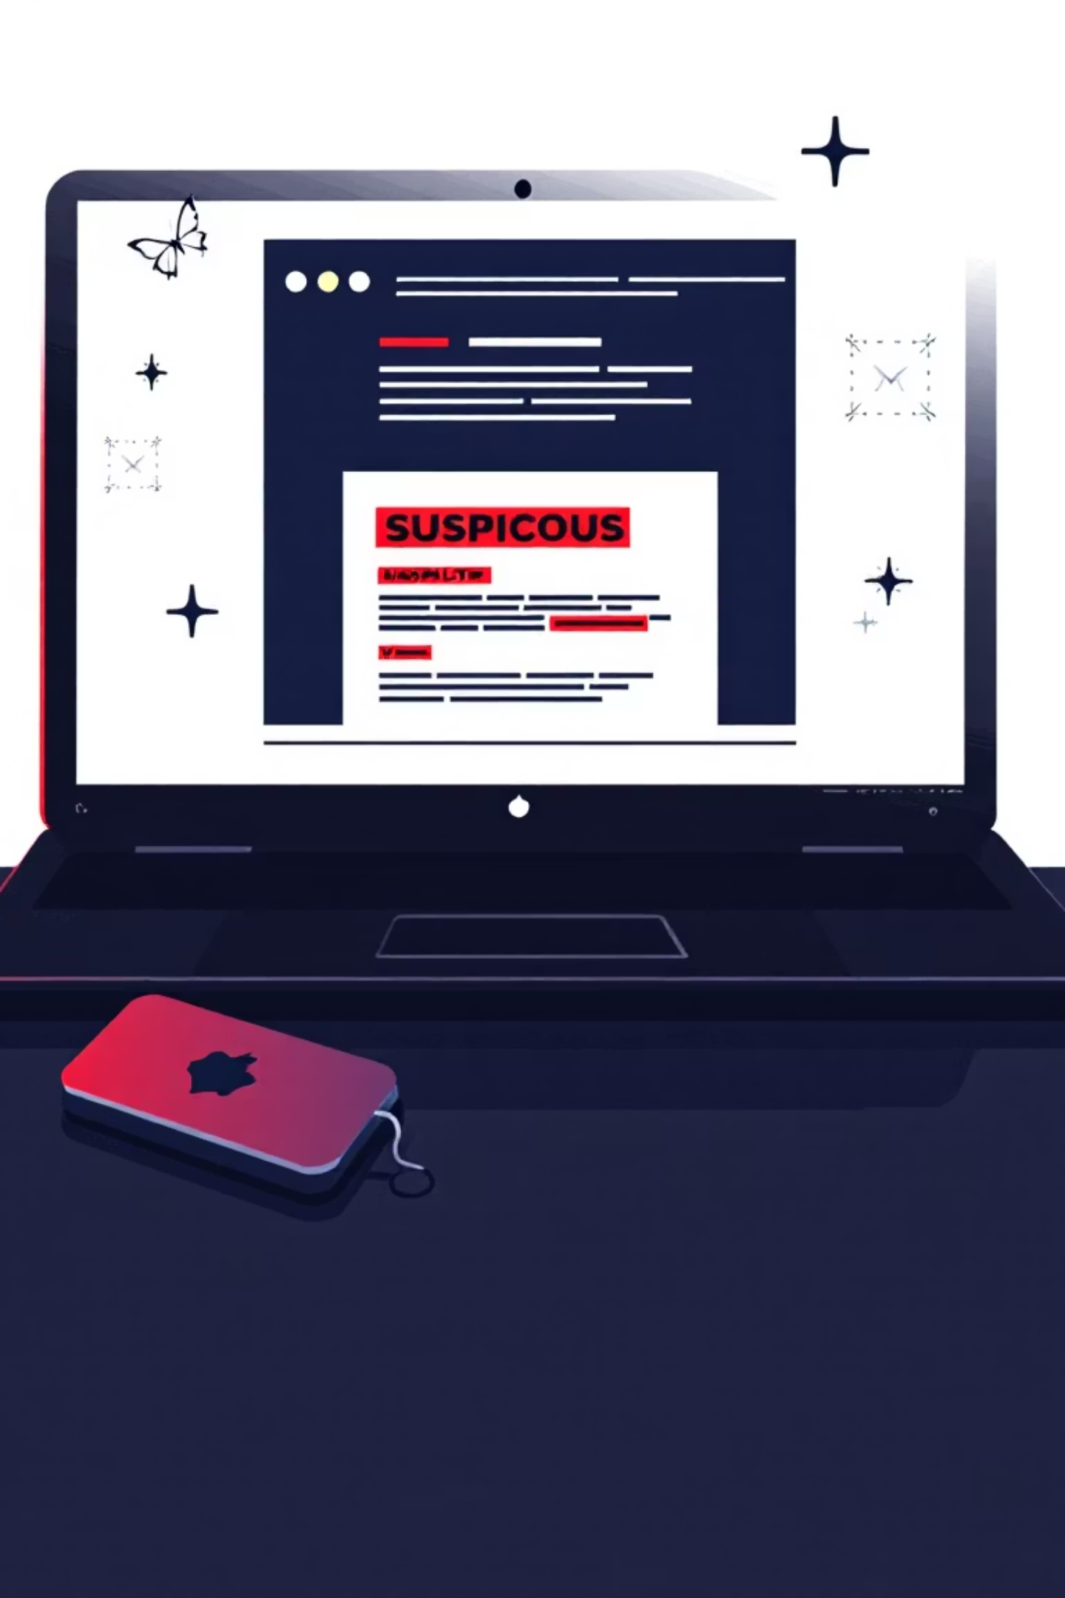
Spotting Phishing Emails
Phishing emails often have tell-tale signs if you know what to look for:
Suspicious Sender
Check the email address carefully. It might look similar but have slight alterations.
Urgent or Threatening Language
Attackers use fear or a sense of urgency to make you act without thinking.
Spelling & Grammar Errors
Professional organisations usually have flawless communication. Errors are a red flag.
Unexpected Links or Attachments
Be wary of links or attachments you weren't expecting, even if from a known sender.

Slide 5
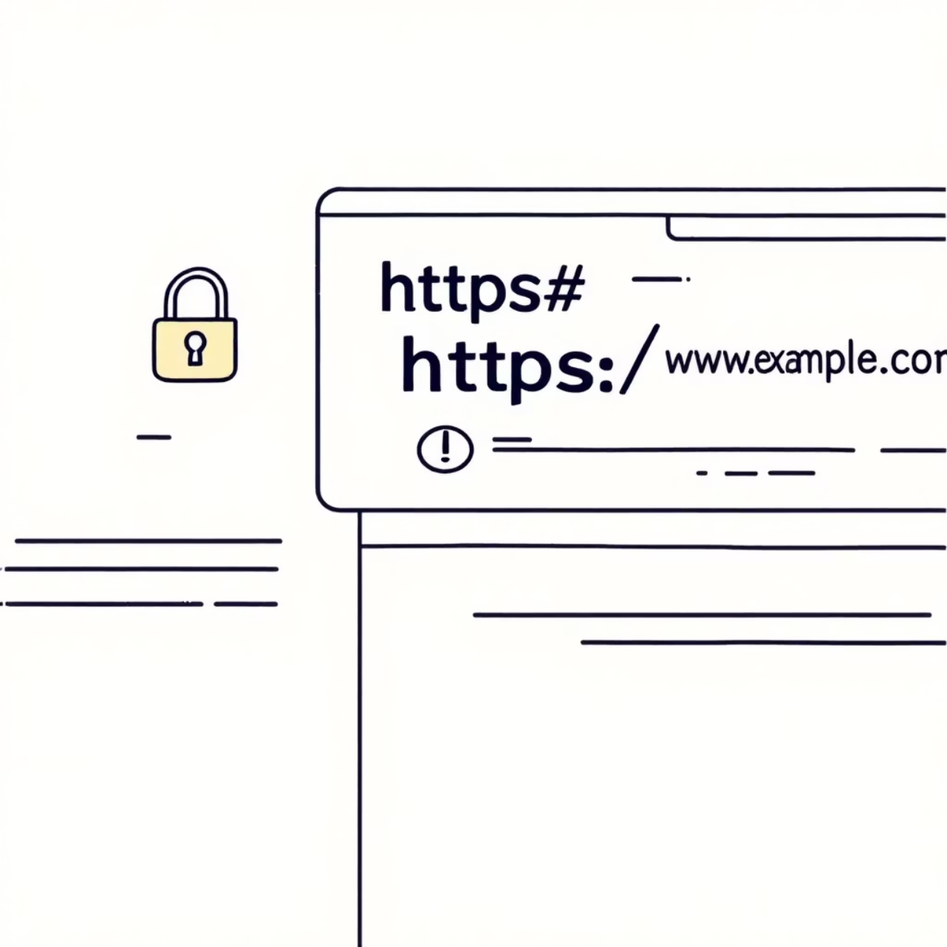
Identifying Fake Websites
Look for HTTPS and a Padlock: Always check if the website URL starts with "https://" and has a padlock icon in the address bar. This indicates a secure connection, though it's not a guarantee of authenticity.
Fake Domain Names: Scammers often create domain names that are very similar to legitimate ones, but with subtle changes. For example, "amaz0n.com" instead of "amazon.com".
Poor Design or Copy-Paste Logos: Low-quality graphics, pixelated logos, or inconsistent branding can be signs of a fake website. If it looks unprofessional, it probably is.

Slide 6




Social Engineering Tactics
Attackers use psychological tricks to manipulate you. Here are some common tactics:
Fear and Urgency
Authority Impersonation
Threats of account closure or legal action to rush your decision.
Pretending to be your boss, IT support, or a government official.
Curiosity & Emotion
Greed and Rewards
Using intriguing headlines or emotionally charged messages to pique your interest.
Offering fake prizes, discounts, or financial gains.

Slide 7
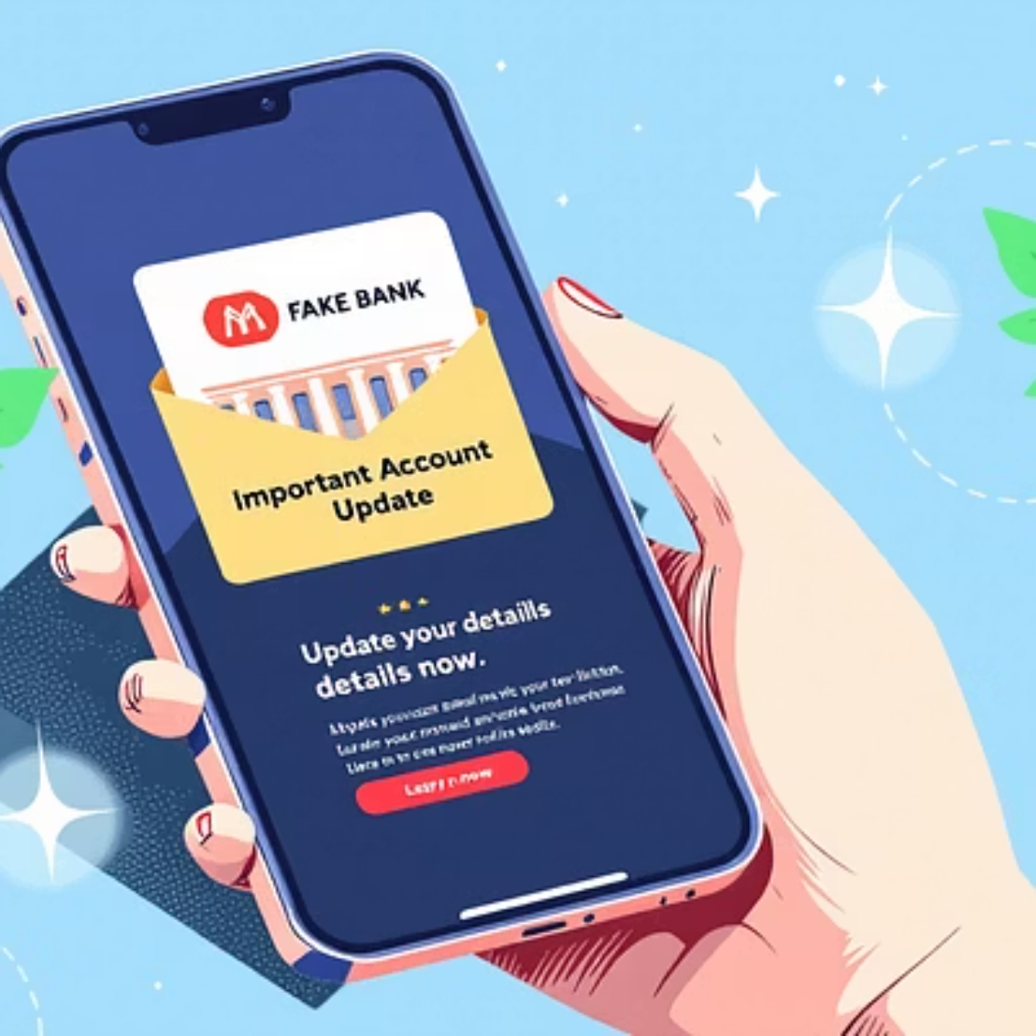
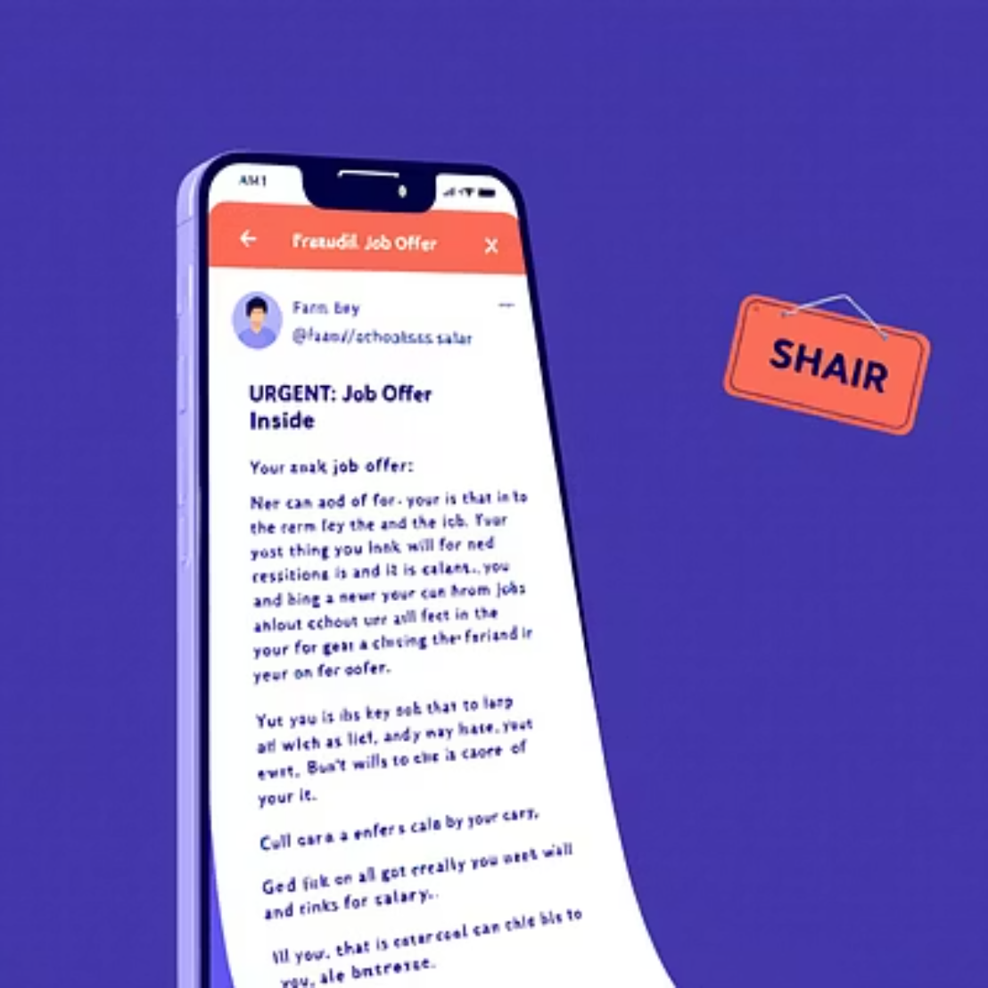
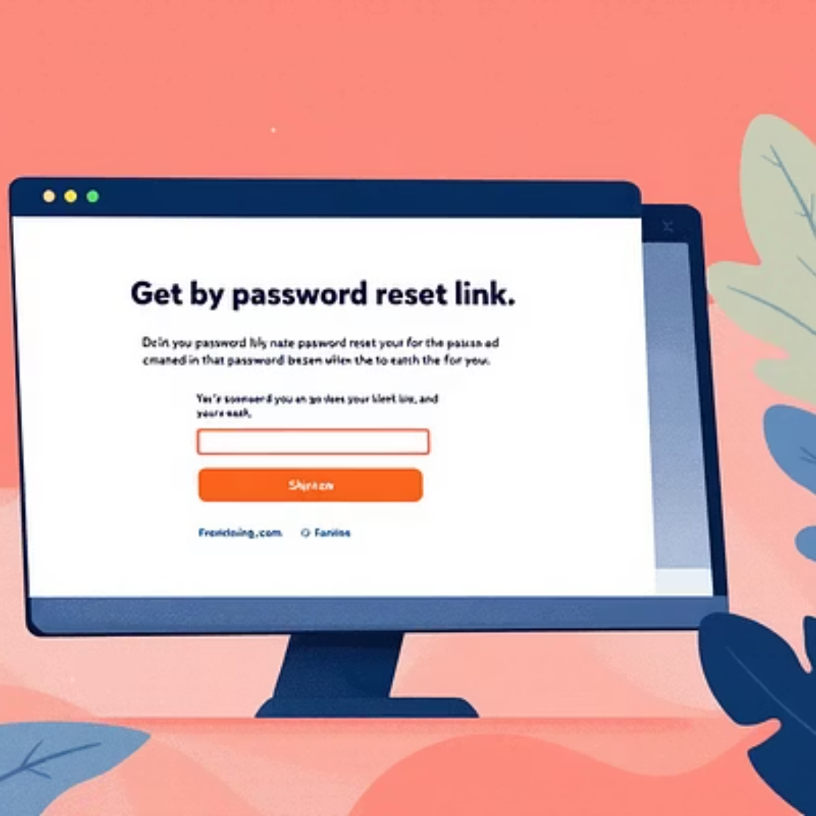
Real-World Phishing Examples
Let's look at some examples of what phishing attempts can look like:
These examples highlight how convincing scammers can make their messages appear. Always be vigilant!

Slide 8
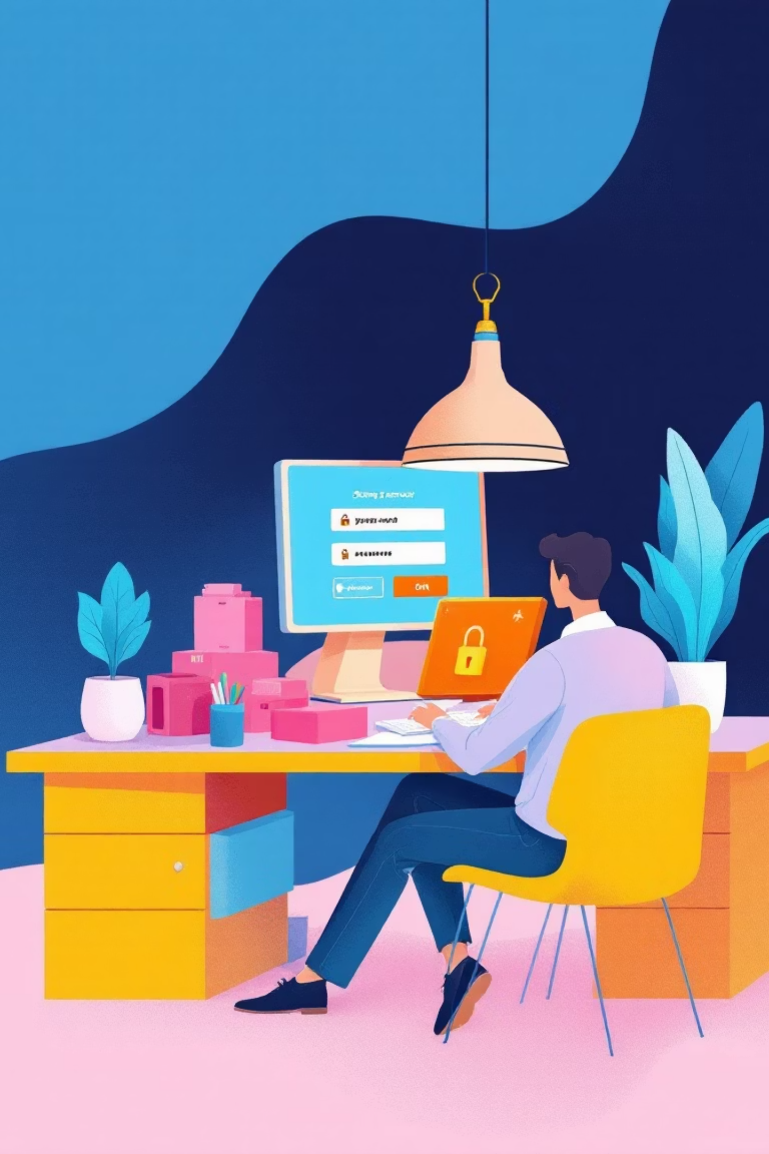
Best Practices to Avoid Phishing
Never Click Suspicious Links
Hover over links to see the actual URL before clicking. If it looks off, don't click.
Verify Sender Identity
If unsure, contact the sender directly through a known, legitimate channel, not the one provided in the email.
Use Strong Passwords
Create complex passwords and use a password manager. Avoid reusing passwords across accounts.
Enable Two-Factor Authentication (2FA)
2FA adds an extra layer of security, making it harder for attackers to access your accounts even with your password.

Slide 9
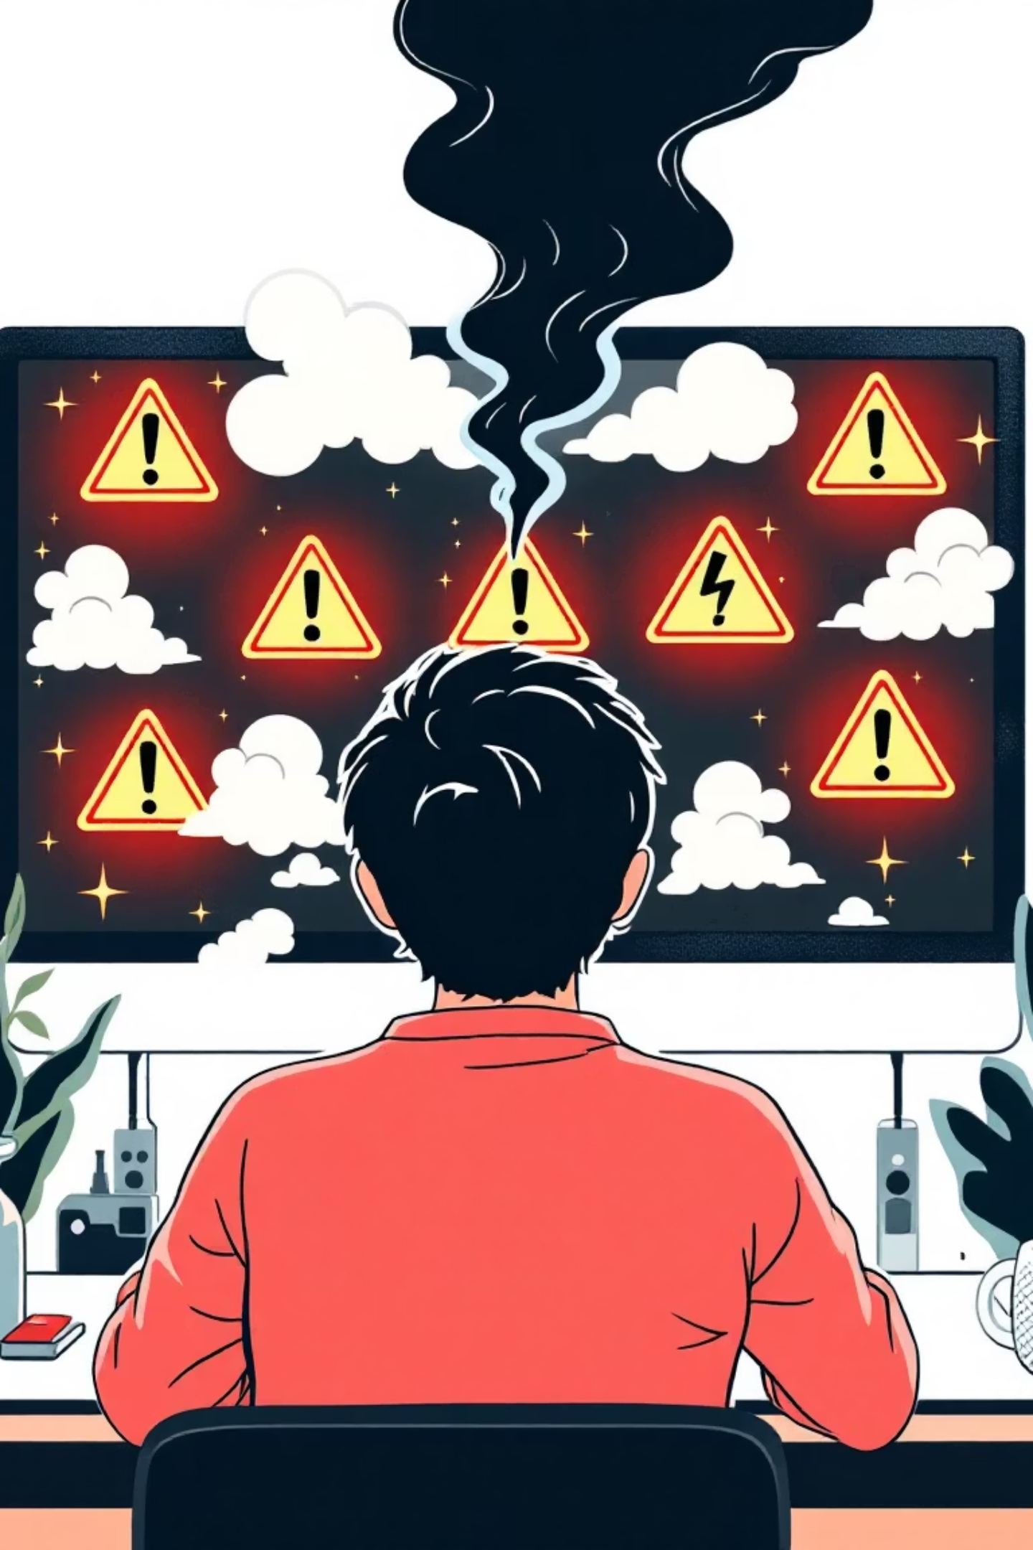
What If You Fall for It?
Accidents happen. If you suspect you've fallen victim to a phishing attack, act fast:
01
02
Change Passwords Immediately
Inform IT/Security Team
Report the incident to your organisation's IT or cybersecurity team without delay.
Update passwords for any compromised accounts, and any other accounts using the same password.
03
Scan Your Device
Run a full scan with your antivirus software to check for any malware that might have been installed.

Slide 10
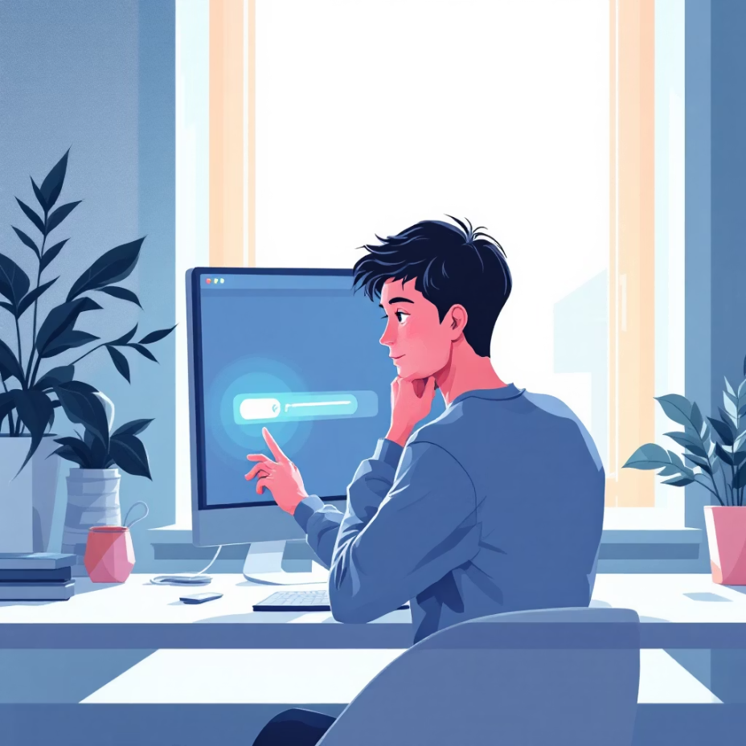
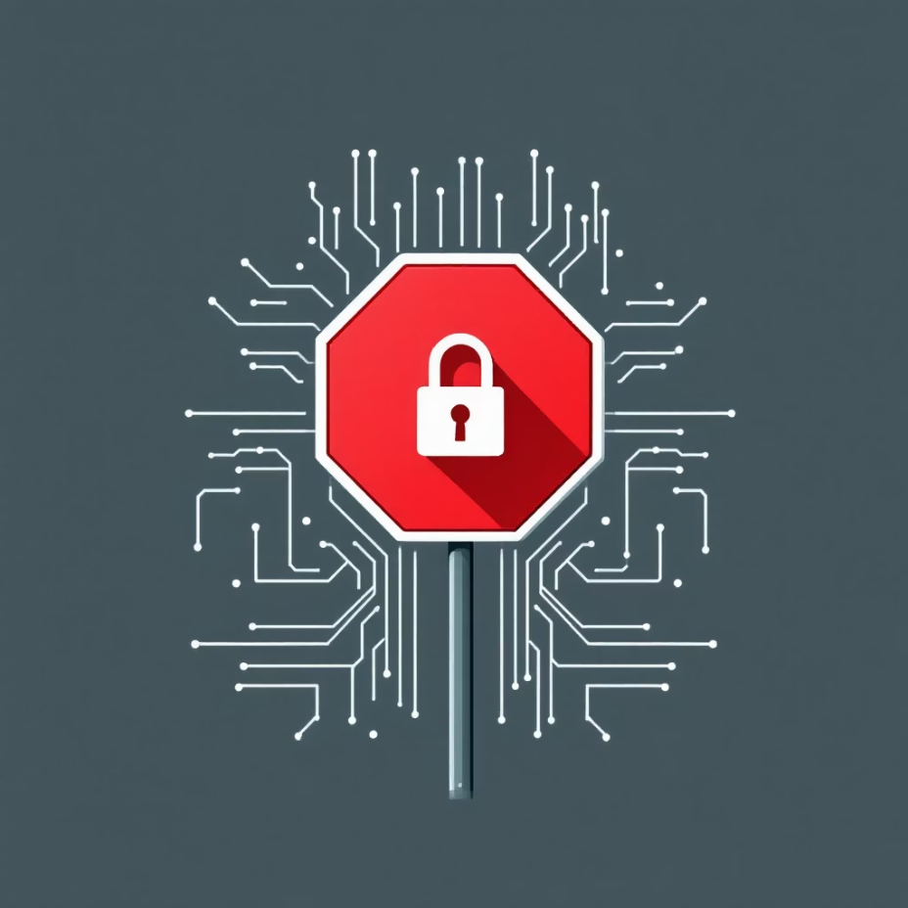
Quick Safety Tips to Remember
Think Before You Click
When In Doubt, Don't Trust
Always take a moment to evaluate the legitimacy of an email, message, or website before interacting with it.
If something feels suspicious, it probably is. It's better to be safe than sorry.
Stay Informed, Stay Secure. Cybersecurity Starts With You!

